Slide 1
Fórmulas Básicas
de Integración

Slide 2
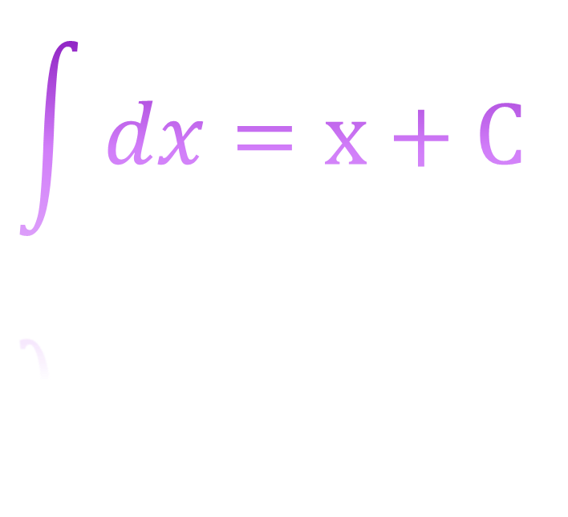
Fórmulas Básicas de Integración
$$\int{dx}=x+C$$

Slide 3
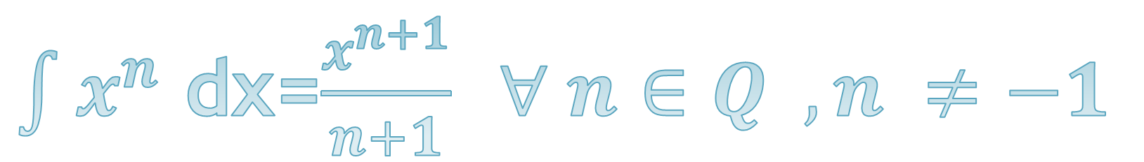
$\int{x^{n}}$ dx=$\frac{x^{n+1}}{n+1} ∀ n∈Q , n ≠−1$

Slide 4
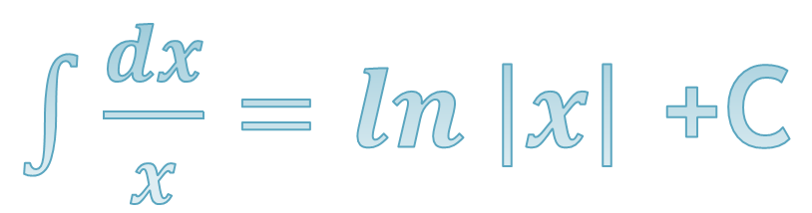
$\int{\frac{dx}{x}}=ln \left|x\right|$ +C

Slide 5

$\int{e^{x} dx}=e^{x}$ + C

Slide 6

$\int{a^{x}}$ dx = $\frac{a^{x}}{\text{lna}}$ + C

Slide 7
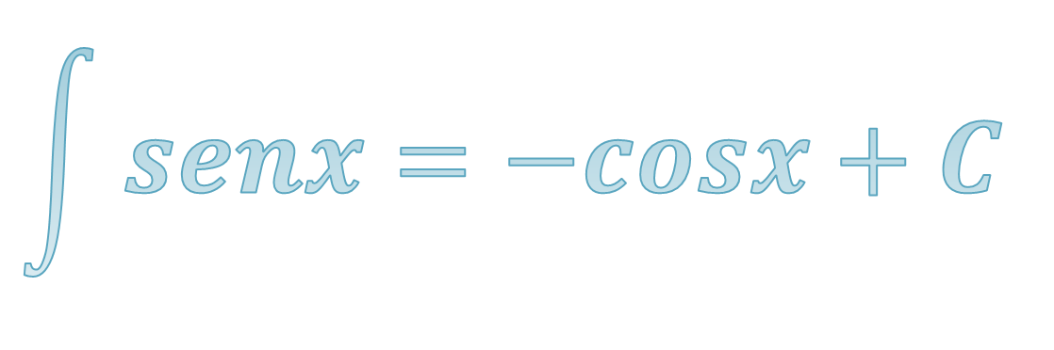
$$\int{senx=−cosx+C}$$

Slide 8
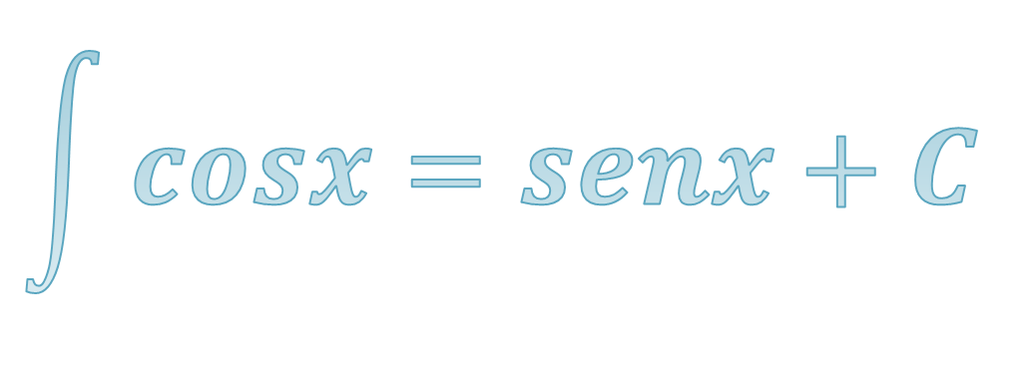
$$\int{cosx=senx+C}$$

Slide 9

$\int{secxtanx=}$ $secx+C$

Slide 10

$\int{cscxctgx=}$ -csc$x+C$

Slide 11
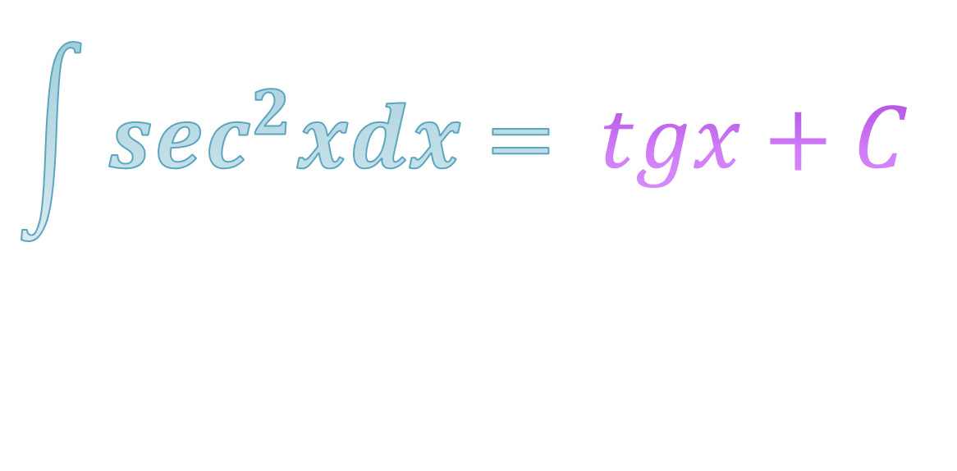
$$\int{\sec^{2}xdx=} tgx+C$$

Slide 12
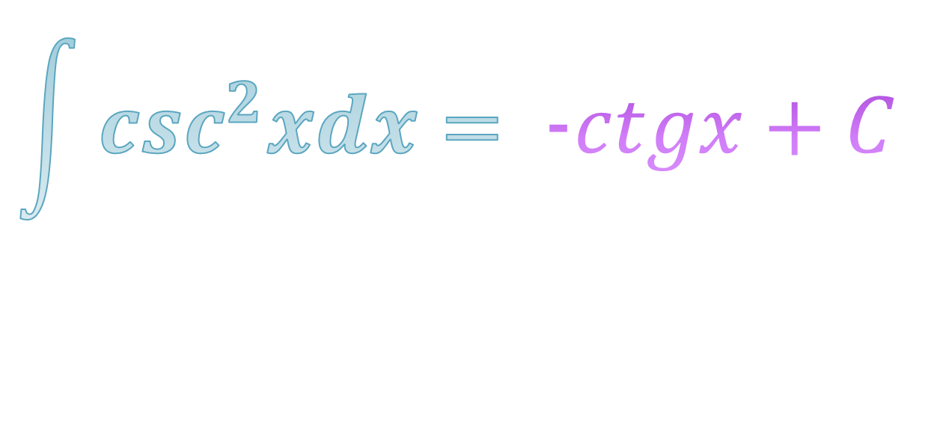
$$\int{\csc^{2}xdx=} \text{−}ctgx+C$$

Slide 13
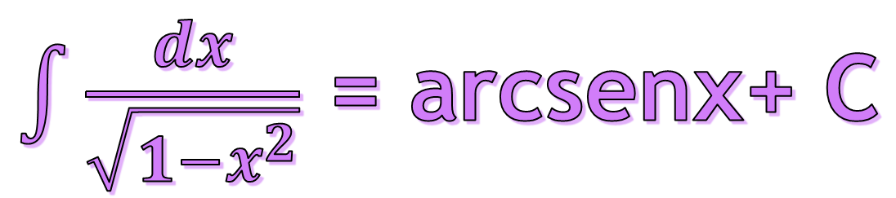
$\int{\frac{dx}{\sqrt{1−x^{2}}}}$ = arcsenx+ C

Slide 14
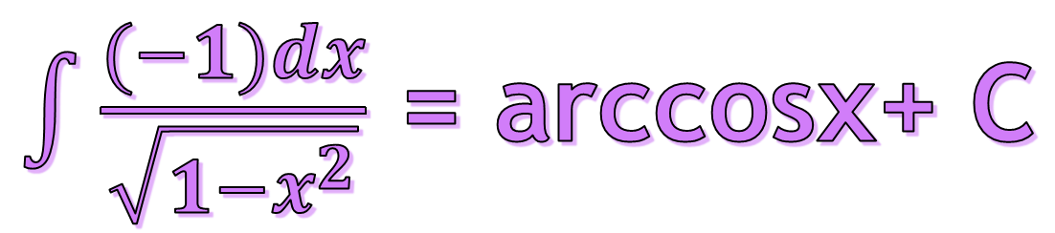
$\int{\frac{(−1)dx}{\sqrt{1−x^{2}}}}$ = arccosx+ C

Slide 15
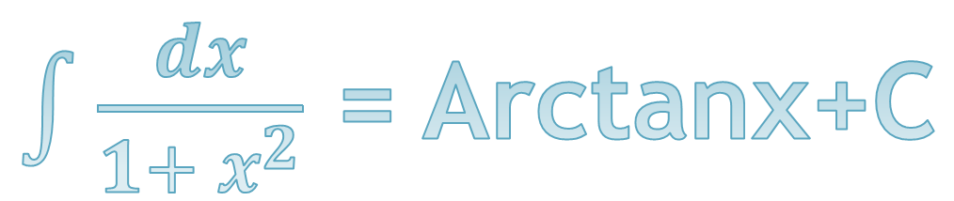
$\int{\frac{dx}{1+ x^{2}}}$ = Arctanx+C

Slide 16
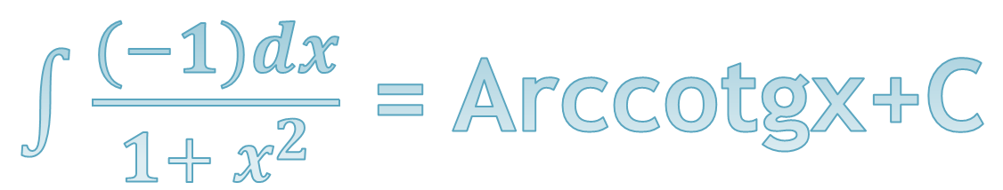
$\int{\frac{(−1)dx}{1+ x^{2}}}$ = Arccotgx+C

Slide 17
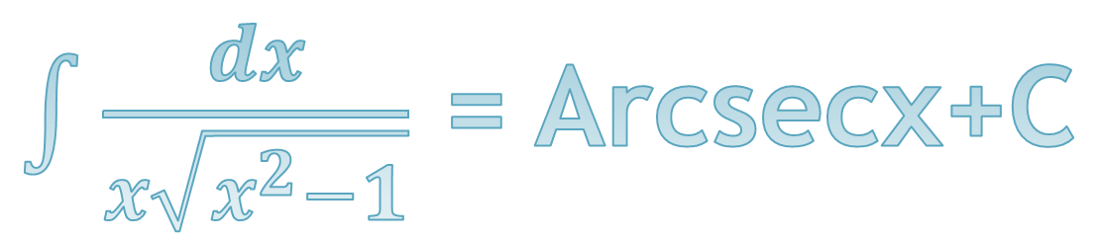
$\int{\frac{dx}{x\sqrt{x^{2}−1}}}$ = Arcsecx+C

Slide 18
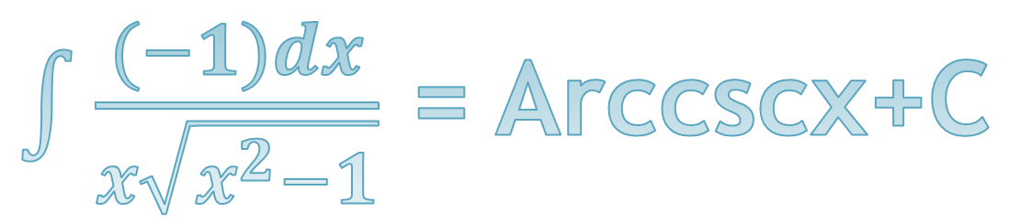
$\int{\frac{(−1)dx}{x\sqrt{x^{2}−1}}}$ = Arccscx+C

